Slide 1







NBA-PTS
MULTIPLE LINEAR REGRESSION
by Urawit Jearrajinda

Slide 2


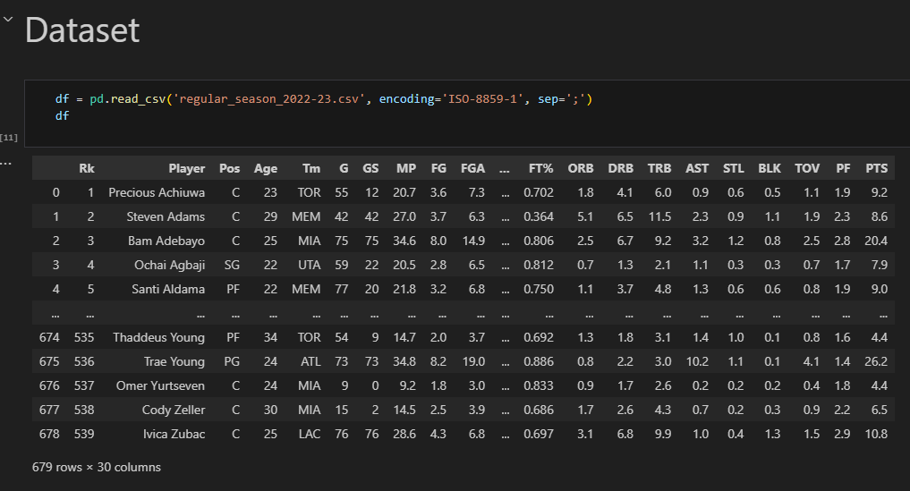
DATASET
from : https://www.kaggle.com/datasets/vivovinco/20222023-nba-player-stats-regular
licensed under the Creative Commons Attribution 4.0 International License (CC BY 4.0).

Slide 3

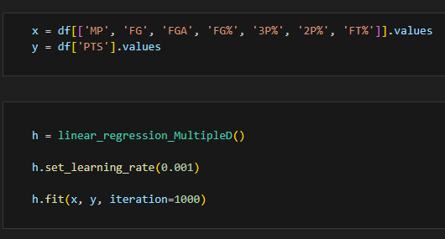
GOAL
to train a model that can predict the points per game (PTS) of NBA players
based on various features such as
minutes played (MP)
field goals made (FG)
field goals attempted (FGA)
field goal percentage (FG%)
three-point percentage (3P%)
two-point percentage (2P%)
free throw percentage (FT%)

Slide 4


REGRESSION MODEL
Using linear regression model enable us to predict the points per game
we can predict the value of a dependent variable based on the values of one or more independent variables. By fitting a regression model to historical data, you can make predictions about future outcomes.
BY URAWIT JEARRAJINDA

Slide 5
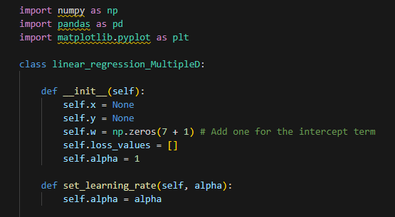

FUNCTION
Initializing

Slide 6
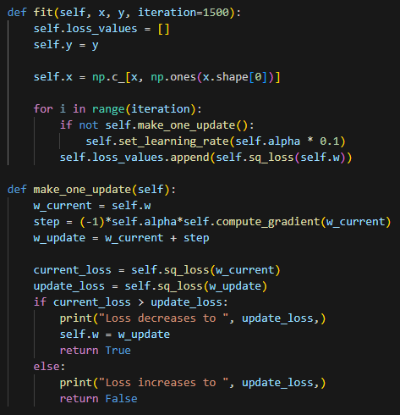
FUNCTION
Fitting
Without an intercept term, the coefficients of the independent variables would change depending on the position of the regression line with respect to the origin, which could lead to misleading interpretations.

Slide 7


FUNCTION
Updating

Slide 8
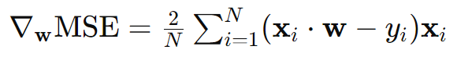
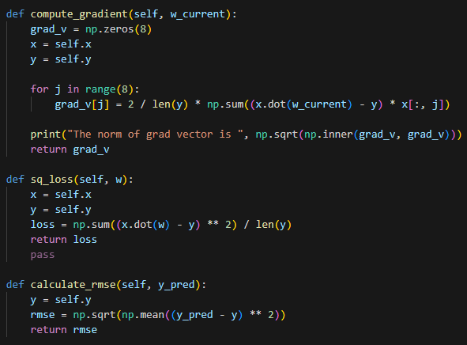
FUNCTION
Computing

Slide 9


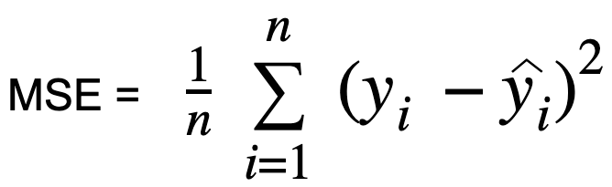
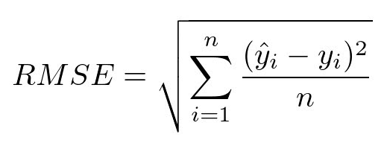
FUNCTION
square loss and RMSE

Slide 10
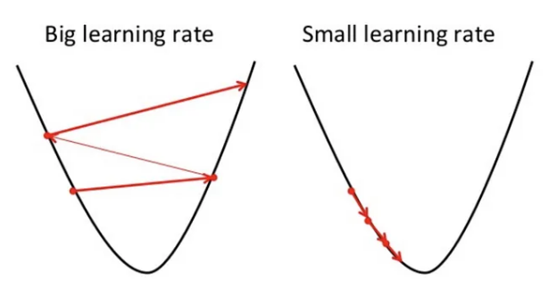
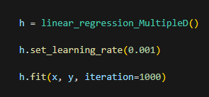
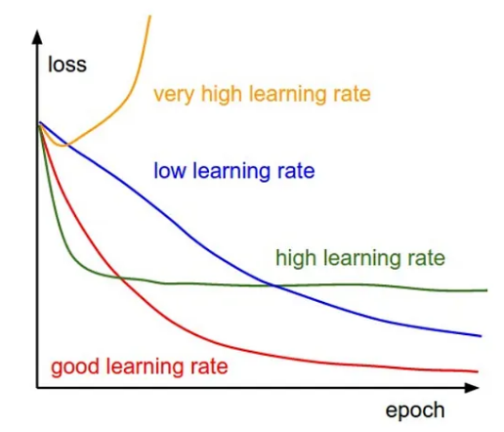

EXCUTION
FUNCTION
setting learning rate
square loss and RMSE

Slide 11
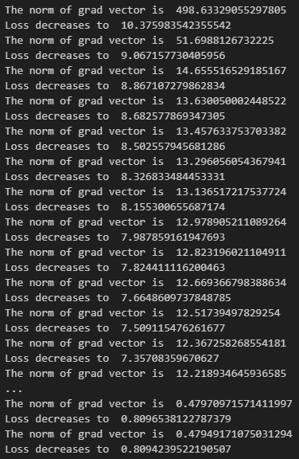
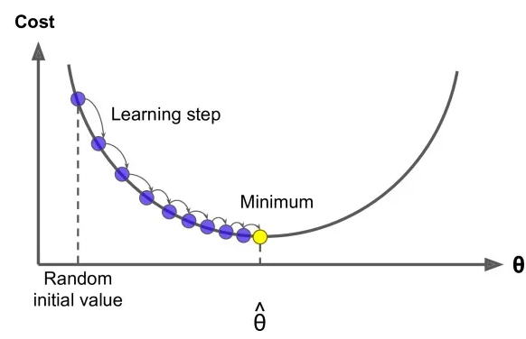

RESULT
loss value is getting closer to the optimal value

Slide 12
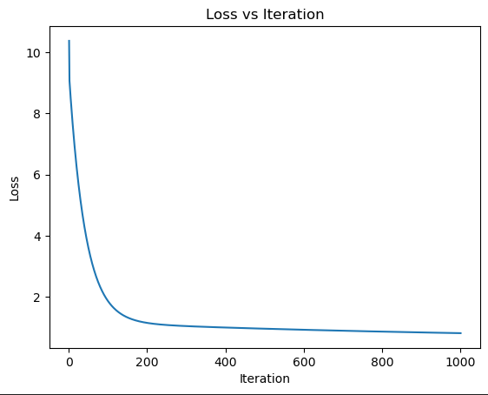


RESULT

Slide 13
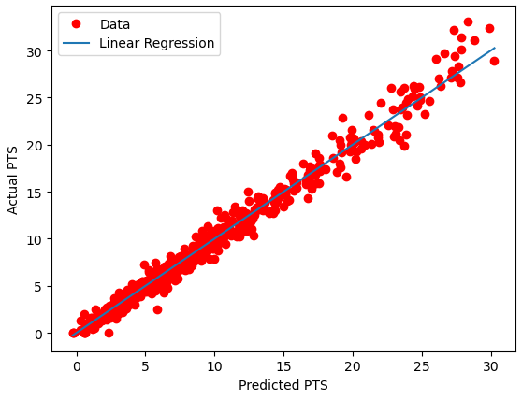
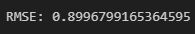
RESULT

Slide 14

THANK YOU FOR LISTENING

